Slide 1
Activity 04: Evaluation
SISMID Lab
July 22 through July 24, 2026
A Human – AI Teaming Approach to Infectious Disease Modeling

Slide 2

General Housekeeping
Any slide with this icon contains the goals and
expected outputs for the activity. All outputs listed in
the tables on these slides should be uploaded to the
course GitHub repository for review.
Any slide with this icon indicates that it is time to complete a hands-on activity. Carefully follow the instructions provided, complete the required task, and verify your results.

Slide 3
Lab Timeline
We are here
Activity 1
Activity 2
Activity 3
Activity 4
Data Cleaning &
Visuals
Data
Exploration
Modeling & Forecasting
Evaluation
Activity 5 Incremental Revisions

Slide 4
Activity Roadmap
The steps we will work through to fit the model and produce forecasts.
1
2
3
4
Write the Rules
Build the Agent
Generate the Script
Run & Commit
Add a Forecasting section to our rules document with precise rules for Task 0 through Task 5.
Regenerate agents.md from your updated rules so the agent follows your new instructions.
Use agents.md to have Copilot write the scripts/03_forecast.R script.
Run it, check the figure and flusight_forecasts.csv, then commit your results to GitHub.
Vague rules = vague output. Be precise about every detail.

Slide 5
Your Task
We will write forecasting rules for the six tasks (rules.md), then use them to generate the agent, the 03_forecast.R script, forecast file (CSV) and figure.
Activity Output | Description
rules.md | Forecasting rules for Tasks 0 - 5 — model details, forecasting, data & figure format.
agents.md | Regenerated from your updated rules so the agent follows your new instructions.
scripts/03_forecast.R | The R code Copilot (or AI of your choosing) writes from the agent to build the figure and forecast file.
figure + flusight_forecasts.csv | The finished outputs: forecast_vs_observed.png and flusight_forecasts.csv.

Slide 6
Evaluation Metrics
Notes:
We Provide

Slide 7
Overview
We are going to focus on calculating some of the primary metrics used by the FluSight challenge, and commonly throughout forecast evaluation
This includes, but is not limited to, mean absolute error (MAE), 95% prediction interval (PI) coverage, and weighted interval score (WIS)
Note that the metrics come with their own strengths and weaknesses, and represent only a minuscule portion of the evaluation approaches available

Slide 8
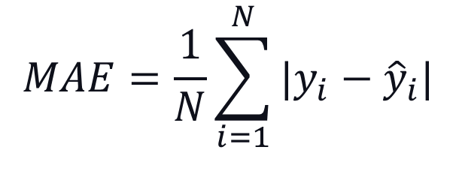
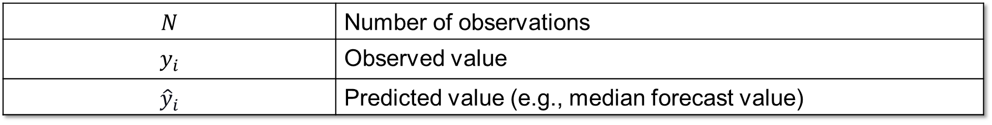
Mean Absolute Error (MAE)
Measure of how accurate point (single value per time point) forecasts are (i.e., how far the model's predictions fall from the observed admission counts).
$$MAE=\frac{1}{N}\sum_{i=1}^{N}{|y_{i}−{\hat{y}}_{i}|}$$
$$N$$ | Number of observations
$$y_{i}$$ | Observed value
$${\hat{y}}_{i}$$ | Predicted value (e.g., median forecast value)
Ideal Value: Lower is better!

Slide 9
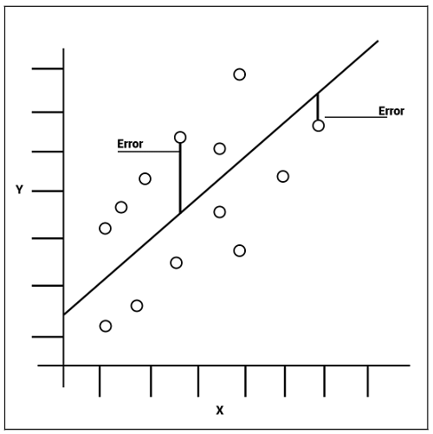

Slide 10
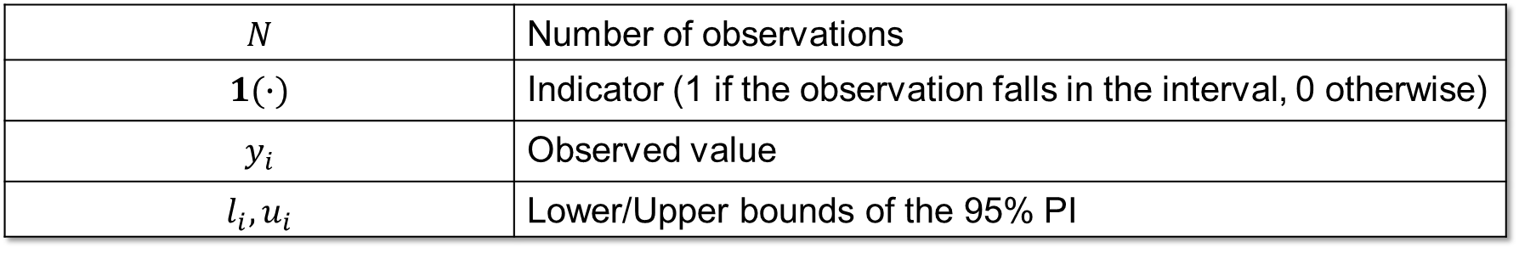
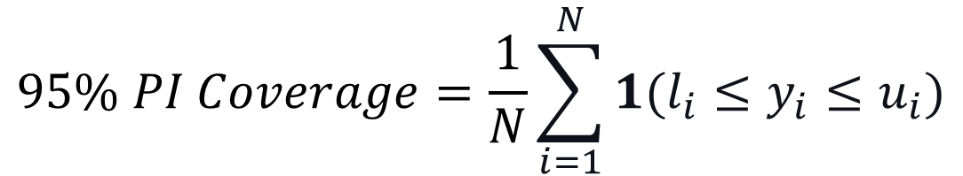
95% Prediction Interval (PI) Coverage
Measures how often the observed value is captured within the bounds of the 95% prediction interval (i.e., measure of how well the model captures uncertainty).
$$95\% PI Coverage=\frac{1}{N}\sum_{i=1}^{N}{1(l_{i}≤y_{i}≤u_{i})}$$
$$N$$ | Number of observations
$$1(∙)$$ | Indicator (1 if the observation falls in the interval, 0 otherwise)
$$y_{i}$$ | Observed value
$$l_{i}, u_{i}$$ | Lower/Upper bounds of the 95% PI
Ideal Value: ~95%; Below 95% = intervals too narrow (overconfident); above 95% = too wide (underconfident).

Slide 11
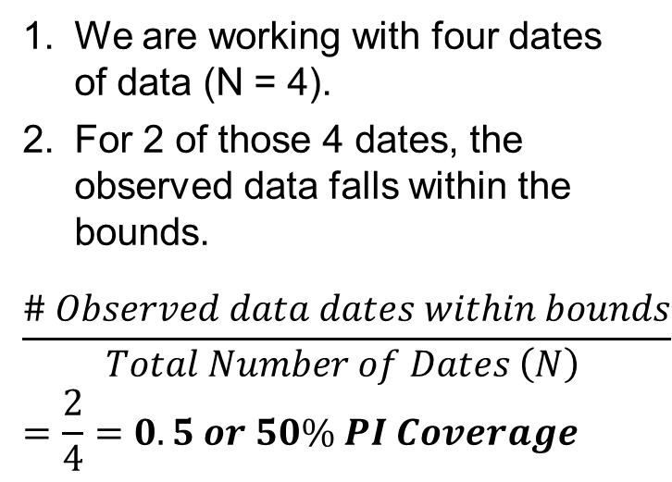
Legend
 | Observed Data
 | Forecasted Median
 | 95% PI Bounds
Calculating the 95% PI Coverage
We are working with four dates of data (N = 4).
For 2 of those 4 dates, the observed data falls within the bounds.
$$\frac{\# Observed data dates within bounds}{Total Number of Dates \left(N\right) }=\frac{2}{4}=0.5 or 50\% PI Coverage$$
Total Influenza Admissions
Weeks
50% is far below the nominal 95%, so these intervals are too narrow — the model is overconfident.

Slide 12
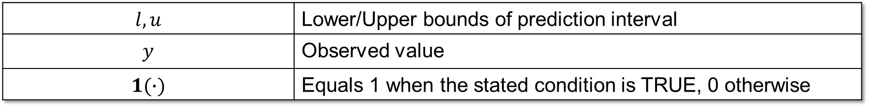
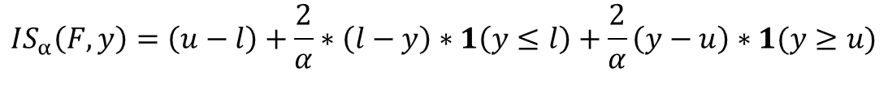
Interval Score (IS)
Measures how well a single prediction interval performs, rewarding intervals that are narrow but penalizing ones that the observed value falls outside, in the units of the observed data.
Overprediction
$$IS_{α}\left(F,y\right)=\left(u−l\right)+\frac{2}{α}∗\left(l−y\right)∗1\left(y≤l\right)+\frac{2}{α}\left(y−u\right)∗1(y≥u)$$
Dispersion
Underprediction
$$l, u$$ | Lower/Upper bounds of prediction interval
$$y$$ | Observed value
$$1(∙)$$ | Equals 1 when the stated condition is TRUE, 0 otherwise
Ideal Value: Lower is better!
Notes:
https://epiforecasts.io/scoringutils/articles/scoring-rules.html?q=interval%20scores#weighted-interval-score-wis

Slide 13
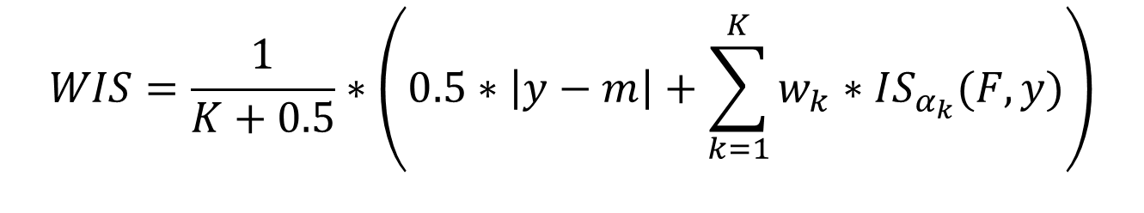
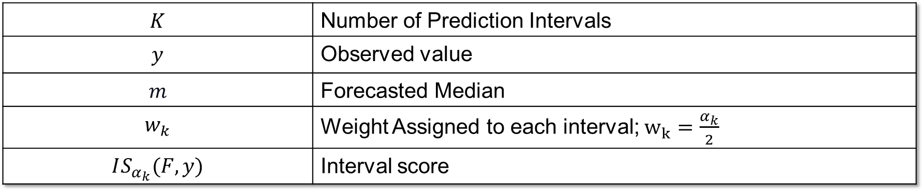
Weighted Interval Score (WIS)
Measures overall forecast quality, focusing on how close the whole predicted distribution is to the observed value, in the units of the observed data. It rewards forecasts that are both accurate and appropriately confident.
$$WIS=\frac{1}{K+0.5}∗\left(0.5∗\left|y−m\right|+\sum_{k=1}^{K}{w_{k}∗IS_{α_{k}}(F,y)}\right)$$
$$K$$ | Number of Prediction Intervals
$$y$$ | Observed value
$$m$$ | Forecasted Median
$$w_{k}$$ | Weight Assigned to each interval; $w_{k}=\frac{α_{k}}{2}$
$$IS_{α_{k}}(F,y)$$ | Interval score
Ideal Value: Lower is better!
Notes:
Quantiles are assumed to be the lower and upper bounds of prediction interval symmetric around the median.

Slide 14
scoringutils Package
What should we use to calculate the metrics?

Slide 15
From Formulas to Code
scoringutils is an R package that provides multiple built-in metrics and proper scoring rules to simplify the process of evaluating probabilistic forecasts against true observed values.
It’s easy to implement (three steps):
We will work through each step together (and with AI) to evaluate our ARIMA models from the last activity.
Prepare the Forecasts
‘Score’ the Forecasts
Summarize the Results

Slide 16
Required Data Format
It expects at least observed, predicted, and quantile_level columns. However, it can take ‘grouping’ variables as well (e.g., location, horizon) that can be used to group and summarize scores.
Our current set-up maps to the package requirements as follows:
Required Package Format | In Hubverse terms | Description
forecast_unit | location, reference_date, horizon, target_end_date, model | The columns that uniquely identify one forecast; also used for later summarization.
observed | cleaned_flu_admissions.csv | The observed truth; we will join the truth data with the forecast file.
predicted | value | The forecasted value.
quantile_level | output_type_id | The quantile the value corresponds to (0 to 1).

Slide 17
Implementation

Slide 18
Overview
Rather than hand-coding the evaluation, we'll write rules in rules.md that an AI uses to build the script (04_evaluation.R), covering the whole pipeline, from preparing the data to writing the output tables.
Our end goal is two tables: one with forecast-by-forecast performance (Rule 3), and one with summary metrics by horizon (Rule 4).
Rule 1
Input Preparation
Rule 2
Scoring with scoringutils
Rule 3
Output table
Rule 4
Summary by horizon

Slide 19
Initial Set-Up
Prior to specifying Rules 1 - 4 for evaluating forecasts, we need to do some initial set-up like we have done for other activities (e.g., headers, file paths, etc.).
Given we specifically want to use the scoringutils package for the entire pipeline, we want to make sure this is clear and respected by the AI. Therefore, we are going to add a global rule specifying this.
# Forecast Evaluation
Save all code in this section to `output/scripts/04_evaluation.R`. If the folder path is not present, create it before saving the script.
Use the **scoringutils** package to compute the metrics — do not hand-code the scoring formulas.
Notes:
# Forecast Evaluation
Save all code in this section to `output/scripts/04_evaluation.R`. If the folder
path is not present, create it before saving the script.
Use the **scoringutils** package to compute the metrics — do not hand-code the scoring
formulas.

Slide 20
Loading the Data (## 1. Input Data)
We need to be explicit about what files we want to include as part of the evaluation.
scoringutils requires both forecasts and observed data in a single data frame; we need to load the files prior to merging them.
File Type | Forecasts | Observed Truth
File Path | output/data/03_forecast/flusight_forecasts.csv | output/data/01_cleaning/cleaned_flu_admissions.csv
File Format | reference_date, target, horizon, target_end_date, location, output_type, output_type_id, value | week, location, value
Notes:
## 1. Input Data
Read the forecasts from `output/data/03_forecast/flusight_forecasts.csv` (the
FluSight long format: one row per `reference_date`, `horizon`, and
`output_type_id` quantile). Read the observed truth from
`output/data/01_cleaning/cleaned_flu_admissions.csv` (`week`, `location`,
`value`).

Slide 21
Joining Forecasts & Truth Data
We now need to join each forecast row to the observed truth by matching on a common variable (Hint: It’s target_end_date & week).
Only forecasts with a matching observed value can be scored. The 2- and 3-week-ahead targets that fall beyond the last observed week have no truth to compare against, so we drop them.
Including a message of how many combinations were dropped for lack of an observed target will act as a check in the code (i.e., is it functioning as it should).
Notes:
Join each forecast row to the observed truth by matching the forecast's
`target_end_date` to the observed `week` (both are US, weekly). Keep only the
reference-date/horizon combinations whose `target_end_date` has an observed
value — the 2- and 3-week-ahead targets that fall beyond the last observed week
cannot be scored and are dropped. Note in a message how many combinations were
dropped for lack of an observed target.

Slide 22
Now it’s your turn!
On your own, use the previous two slides to specify rules to load the proper data files and merge them on a common key (Hint: target_end_date & week)
1
Create the ## 1. Input Data section header under the initial set-up code in rules.md.
Write detailed rules to load the two needed files (Hint: provide the file paths for the forecasts & observed data), merge them on a common key, and drop targets with no observed value.
2
3
Regenerate agents.md from your updated rules document.
4
Use the agents.md file and Copilot (or your preferred AI) to generate scripts/04_evaluation.R. Run the script and check the output.

Slide 23
Shaping the Data (## 2. Scoring with scoringutils)
scoringutils only recognizes its own column names, so before scoring we relabel the joined data to match its conventions.
The FluSight data is already long (one row per quantile), so this is a rename, not a reshape. No pivoting needed; we're relabeling columns, not restructuring rows.
Three renames: output_type_id → quantile_level, value → predicted, and the joined truth value → observed.
Add a constant model column (e.g. "arima"). scoringutils is built to compare models, so it expects a model label; with only one model we still include it, since it's part of the forecast unit.
Notes:
## 2. Scoring with scoringutils
Shape the joined data into the long quantile format that scoringutils expects,
renaming columns to its conventions: `output_type_id` → `quantile_level`,
`value` → `predicted`, and the joined truth → `observed`. Add a constant
`model` column (e.g. `"arima"`).

Slide 24
Scoring the Forecast
Prior to scoring the forecast (i.e., evaluating the forecasts), we convert our new data frame to a forecast object (data table with class of forecast).
scoringutils::as_forecast_quantile() creates the forecast object; we specify the forecast unit (what defines a unique forecast). This allows each reference_date × horizon combination to be evaluated as its own forecast.
Forecast unit: reference_date, horizon, target_end_date, location, model
Finally, we call scoringutils::score() on our forecast object.
Notes:
Build the forecast object with `scoringutils::as_forecast_quantile()`, setting
the forecast unit to `reference_date`, `horizon`, `target_end_date`, `location`,
and `model` so each `reference_date` × `horizon` is scored as its own forecast.
Then call `scoringutils::score()` on it.

Slide 25
Extracting the Metrics
scoringutils provides a plethora of metrics. We can provide rules to make sure that the AI extracts (or calculates) only the metrics we want:
As a precaution, we can give back up options (think substitute options) in case a metric cannot be extracted. For example, for 95% PI coverage:
WIS: The wis column returned by score().
AE: the ae_median column (absolute error of the median); averaged across reference dates it becomes MAE (Rule 4).
95% PI coverage: The 95% interval coverage metric.
If score()’s defaults do not already include it, add it via scoringutils' interval-coverage
metric at the 95% range (e.g. supply a custom interval_coverage metric with
the interval range set to 95).
Notes:
From the scored output, take the metrics FluSight reports:
- **WIS** — the `wis` column returned by `score()`.
- **MAE** — the `ae_median` column (absolute error of the median forecast).
- **95% PI coverage** — the 95% interval-coverage metric. If `score()`'s
defaults do not already include it, add it via scoringutils' interval-coverage
metric at the 95% range (e.g. supply a custom `interval_coverage` metric with
the interval range set to 95).

Slide 26
Now it’s your turn!
We will work through the following steps together to add the next section to our rules.md document.
1
Create the ## 2. Scoring with scoringutils section header in rules.md.
Write detailed rules to shape the data, score the forecast, and extract the metrics of interest (e.g., AE, WIS, 95% PI coverage).
2
3
Regenerate agents.md from your updated rules document.
4
Use the agents.md file and Copilot (or your preferred AI) to generate scripts/04_evaluation.R. Run the script and check the output.

Slide 27
## 3. Output Table
Now that we have extracted our metrics, we can begin to prepare the output table(s).
First, we want a table with one row per evaluated reference_date and horizon combination, with columns for reference_date, horizon, target_end_date, observed, WIS, AE, and coverage_95.
Example Table: Sorted ascending by reference_date, then horizon. Metrics rounded to one decimal.
reference_date | horizon | target_end_date | observed | WIS | AE | coverage_95
2025-09-27 | 1 | 2025-10-04 | 976 | 332.2 | 174 | 1
2025-09-27 | 2 | 2025-10-11 | 1016 | 577 | 202 | 1
2025-09-27 | 3 | 2025-10-18 | 1119 | 754 | 99 | 1
File path to save to: `output/data/04_evaluation/forecast_scores.csv` (create the folder if absent).
Notes:
## 3. Output Table
Keep one row per scored `reference_date` × `horizon` with these columns in
order: `reference_date`, `horizon`, `target_end_date`, `observed`, `WIS`,
`MAE`, `coverage_95`. Sort ascending by `reference_date`, then `horizon`. Round
`WIS` and `MAE` to one decimal.
Print the table to the console and write it to
`output/data/04_evaluation/forecast_scores.csv` (create the folder if absent).

Slide 28
Now it’s your turn!
On your own, use the previous slides to specify rules to format the first of two output tables (Hint: your only task is to reformat the results we already have).
1
Create the ## 3. Output Table section header under the ## 2. Scoring with scoringutils header in rules.md.
Write detailed rules to create the first output table (Hint: refer to previous slide for format), sort by reference date and then horizon, round the metrics to one decimal, and print & save the table.
2
3
Regenerate agents.md and use it and Copilot (or your preferred AI) to generate scripts/04_evaluation.R. Run the script and check the output.

Slide 29
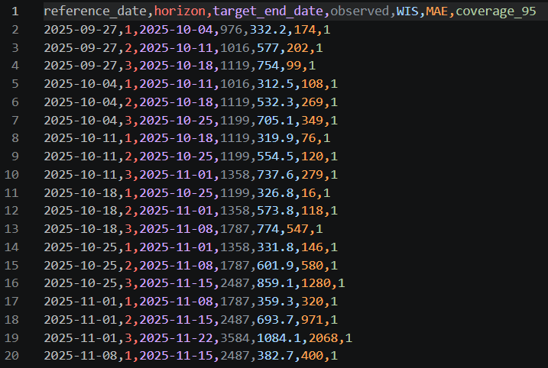
Expected Output

Slide 30
## 4. Summary by Horizon
This is where per-forecast scores become forecast skill. Averaging each horizon's scores across all its reference dates shows how accuracy changes with lead time.
We want one row per horizon: the mean of WIS, MAE, and coverage_95, the min/max of WIS and MAE, and n (# reference dates). The mean of the 0/1 coverage is the empirical 95% coverage rate
Example Table: sorted ascending by horizon. WIS_* and MAE_* rounded to one decimal, coverage_95_mean to two.
horizon | n | WIS_mean | WIS_min | WIS_max | MAE_mean | MAE_min | MAE_max | coverage_95_mean
1 | 34 | 245.8 | 88.4 | 512.6 | 168.3 | 42.0 | 388.0 | 0.92
2 | 34 | 431.5 | 190.2 | 803.1 | 236.7 | 95.0 | 511.0 | 0.82
3 | 34 | 612.9 | 268.7 | 1094.4 | 331.4 | 99.0 | 702.0 | 0.70
File path to save to: `output/data/04_evaluation/forecast_scores_by_horizon.csv` (create the folder if absent).
Notes:
## 4. Summary by Horizon
Summarize the per-reference-date scores across all reference dates, grouped by
`horizon`, to show how forecast skill changes with lead time. For each horizon
(`1`, `2`, `3`), compute over that horizon's scored reference dates:
- the **mean** of `WIS`, `MAE`, and `coverage_95` (the mean of the 0/1 coverage
is the empirical 95% coverage rate), and
- the **range** (minimum and maximum) of `WIS` and `MAE`.
Assemble one row per horizon with these columns in order: `horizon`, `n`
(number of scored reference dates), `WIS_mean`, `WIS_min`, `WIS_max`, `MAE_mean`,
`MAE_min`, `MAE_max`, `coverage_95_mean`. Sort ascending by `horizon`. Round the
`WIS_*` and `MAE_*` columns to one decimal and `coverage_95_mean` to two.
Print this table to the console and write it to
`output/data/04_evaluation/forecast_scores_by_horizon.csv`.

Slide 31
Now it’s your turn!
On your own, use the previous slides to specify rules to format the second of two output tables (Hint: your only task is to reformat the results we already have).
1
Create the ## 4. Summary by Horizon section header under the ## 3. Output Table header in rules.md.
Write detailed rules to create the second output table (Hint: refer to previous slide for format). Group by horizon, compute the mean of WIS, MAE, and coverage_95 plus the min/max of WIS and MAE, sort ascending by horizon, round WIS/MAE to one decimal and coverage_95_mean to two, then print & save the table.
2
3
Regenerate agents.md and use it and Copilot (or your preferred AI) to generate scripts/04_evaluation.R. Run the script and check the output.

Slide 32

Expected Output

